Slide 1
Module-06: Part-3: File Parsing CSV
CS 1714 - Intro to Programming II

Slide 2


Reading from a File
Open the file (and make sure it opened)
Use a file reading function: fgetc(), fgets(), or fscanf()
The function is usually called within an indefinite loop (e.g., while)
Close the file when done with fclose()

Slide 3
Working with File Content
Parsing the input breaks the input data into meaningful and manageable parts. For example, if you read in a sentence, you could parse it into the different words or individual characters. Parsing depends on how your file is organized and the goal of your program.
When inputting file content, we usually have to store the data in our program (e.g., variables, arrays, arrays of structs, etc) so we can continue to work with the data throughout the program runtime. This may first require you to parse out the data.
We will learn how to parse data read in from CSV.

Slide 4

Comma Separated Values
CSV (comma-separated value) files is a standard format for storing data in a tabular format. CSV files are stored in a plain-text format and can be viewed in any text editor (e.g., vim) and can even be opened in Excel. CSV files are a popular way for agencies to share data online.
When you look at a CSV file, you will see rows of data where each row has several values separated by commas. Here is an example of a CSV file of a list of product inventory. Each row has the product name, quantity, and price separated by commas. In this example, there is also a header row, which is optional, telling us what each “column” is.
product,quantity,price
Apple,10,1.25
Banana,28,.99
Orange,150,1.79

Slide 5
Comma Separated Values (cont’d)
CSV files are usually auto-generated (e.g., from databases).
CSV files are also known as comma-delimited files. Also, commas are the most common delimiter used to separate the values, but other characters can also be used (e.g., |).
Some CSV files will also surround each value in quotes!
We will only work with basic CSV files.

Slide 6
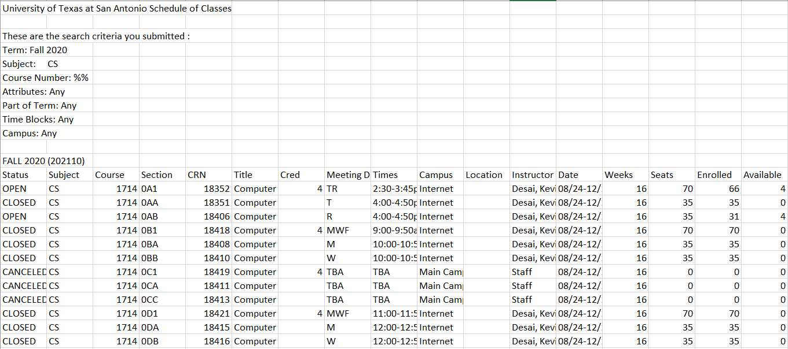
CSV Files
Did you know that the UTSA Schedule of Classes generates a CSV file of its schedule? Here is a snapshot of part of that CSV file. There are 12 leading rows plus a header row, the data, and a summary row. It also has 21 columns of information. If you wanted to work with main part of the data, your program has to extract out the meaningful pieces.

Slide 7
fgets()
Use fgets() to read in each row of the CSV file. It uses a while loop to keep reading until it cannot read anymore, when fgets() returns NULL. Make sure the length is wide enough to read in all the characters in a row.
For each iteration of the loop, the destination variable (buffer) has the current row of data, which will need to be parsed. You must also consider if there are header row(s) that you still need to read in but may have to ignore.
char buffer[500];
while(fgets(buffer, 500, fileIn) != NULL)
{
printf("%s\n", buffer);
/* buffer now has one row from the CSV that is ready for parsing */
}

Slide 8
sscanf()
This function is used to parse out a string into separate values (i.e., variables). sscanf() is useful when you have a line of text that has a specific structure.
int sscanf(const char* str, const char *format, …)
/* Example */
char buffer[100] = "235,238,15";
int a, b, c;
sscanf(buffer, "%d,%d,%d", &a, &b, &c);
printf("%d %d %d", a, b, c) ;
sscanf() will “break” up the buffer string by data types that we can work on it individually.

Slide 9
Using sscanf() with fgets()
Here is an example of how to use sscanf() and fgets() to read in each CSV row and parse out the data. In this case, we are just printing out these individual values, but you can also use them or save them for further analysis.
/* read formatted line using fgets() and sscanf() */
char buffer[1024];
int arg2;
double arg3;
while(fgets(buffer, 1024, fileIn) != NULL)
{
sscanf(buffer, "%d,%lf", &arg2, &arg3);
printf("%d %lf\n", arg2, arg3);
}
Here, each CSV row has an integer followed by a double separated by a comma.
Notice the comma is also in the sscanf() statement.
Notes:
Fgets puts it in the buffer

Slide 10
Using sscanf() with commas
If your CSV row involves a string, you cannot simply use %s in sscanf() to get a column of information. It will treat the commas and all other characters in that row as part of the string and therefore, reads in the rest of the line.
We have to use a special token in sscanf to grab everything until the first comma: %[^,]. This format specifier allows us to read in a string up to but not including the comma.
char buffer[1024];
char arg1[100];
int arg2;
double arg3;
while(fgets(buffer, 1024, fileIn) != NULL)
{
sscanf(buffer, "%[^,],%d,%lf", arg1, &arg2, &arg3);
printf("%s %d %lf\n", arg1, arg2, arg3);
}
Notice the comma is also in the sscanf() statement.

